Slide 1
Heapsort
Chapter 6

Slide 2
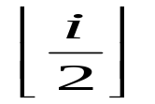
Heaps
A data structure with
  Nearly complete binary tree
  Heap property: A[parent(i)] ≥ A[i]
eg.
Parent(i) { return }
Left(i) { return 2i}
Right(i) { return 2i+1}
1
16
2
3
14
10
4
5
6
7
8
7
9
3
8
9
10
2
4
1
1
2
3
4
5
6
7
8
9
10
16
14
10
8
7
9
3
2
4
1

Slide 3
Binary tree
Contains no node, or
eg.
A node without subtree is called a leaf.
In a full binary tree, each node has 2 or NO children.
A complete binary tree has all leaves with the same depth and all internal nodes have 2 children.
root
Left subtree
right subtree

Slide 4
Maintaining the heap property
Condition:
A[i] may be smaller than its children.
A[i]
Heaps

Slide 5
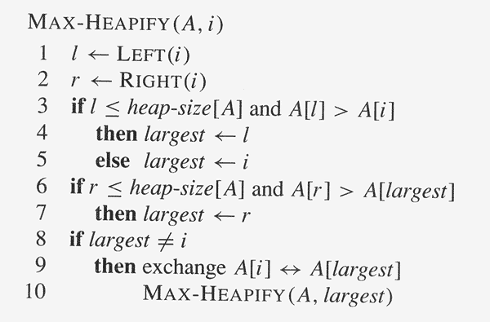
Pseudocode Heapify(A,i)
Time: O(lg n), T(n)≤T(2n/3)+Θ(1)

Slide 6
Heapify(A,2):
Heapify(A,4):
1
1
16
16
2
3
2
3
4
10
14
10
4
5
6
7
4
5
6
7
14
7
9
3
4
7
9
3
8
9
10
8
9
10
2
8
1
2
8
1
Heapify(A,9):
1
16
2
3
14
10
4
5
6
7
8
7
9
3
8
9
10
2
4
1

Slide 7
Build Heap
1
2
3
4
5
6
7
8
9
10
A
4
1
3
2
16
9
10
14
8
7
4
1
4
1
2
3
2
3
1
3
1
3
4
5
6
7
4
5
6
7
2
16
i
9
10
2
i
16
9
10
8
9
10
8
9
10
14
8
7
14
8
7
4
1
4
1
2
3
2
3
1
3
i
1
i
10
4
5
6
7
4
5
6
7
14
16
9
10
14
16
9
3
8
9
10
8
9
10
2
8
7
2
8
7

Slide 8
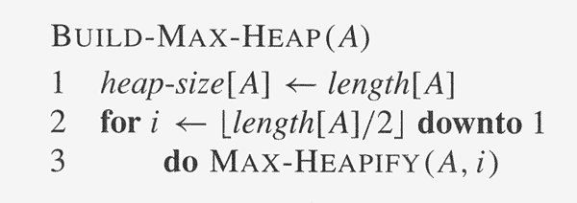
4
1
1
i
16
2
3
2
3
16
10
14
10
4
5
6
7
4
5
6
7
14
7
9
3
8
7
9
3
8
9
10
8
9
10
2
8
1
2
4
1

Slide 9

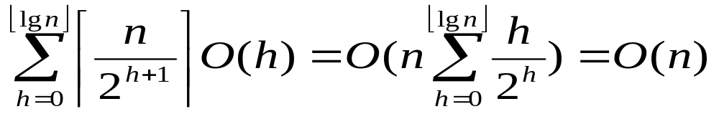
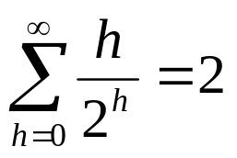
Analysis
h = k
k-1
…
1
0
By intuition:
  Each call of Heapify cost Θ(lg n). There are O(n) calls. Thus, Build-Heap takes O(n lg n).
Tighter analysis: O(n)
  Assume n = 2^{k}-1, a complete binary tree. The time required by Heapify when called on a node of height h is O(h).
  Total cost =
  by exercise:

Slide 10
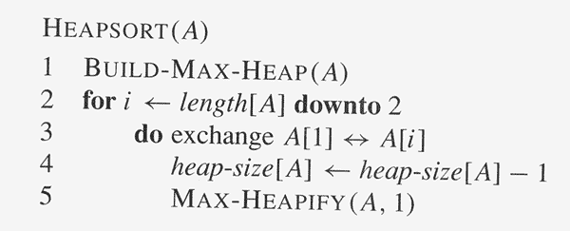
Heapsort algorithm
----O(n)
----O(lg n)
Time cost = O(n lg n)

Slide 11
Priority queue
A data structure for maintaining a set S of elements, each with an associated value called a key.
Application:
  Job scheduling
  Simulation
Operations of a priority queue:
  Insert(S,x)
  Maximum(S)
  Extract-Max(S)
Implement with a heap.

Slide 12
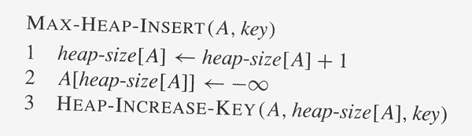
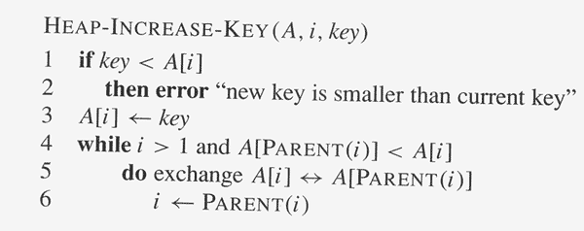
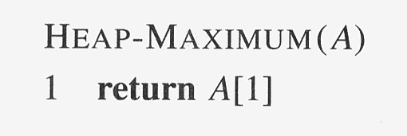
----O(lg n)

Slide 13
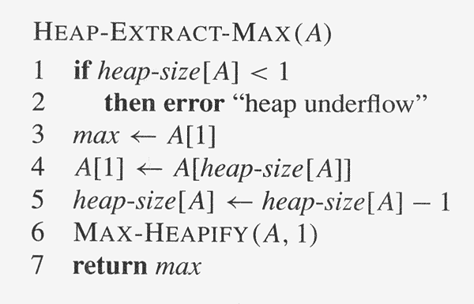
----O(lg n)

Slide 14
key = 15, HeapInsert(A,key):
1
1
16
16
A
2
3
2
3
14
10
14
10
4
5
6
7
4
5
6
7
8
7
9
3
8
7
9
3
8
9
10
8
9
10
11
2
4
1
2
4
1
15
1
1
16
16
2
3
2
3
14
10
15
10
4
5
6
7
4
5
6
7
8
15
9
3
8
14
9
3
8
9
10
11
8
9
10
11
2
4
1
7
2
4
1
7

Slide 15
